Slide 1
Recruitment Information for the National Institute of Teaching

Slide 2
Who We Are
School-Led Development Trust (SLDT) is a charitable company with an unswerving commitment to teacher education and ongoing professional development.
SLDT’s four foundation partners are large, multi-academy trusts with outstanding track records in school-led university-accredited teacher development: Harris Federation, Oasis Community Learning, Outwood Grange Academies Trust and Star Academies.
We have joined together to form a proposition to lead and operate the transformative National Institute of Teaching.

Slide 3
Our Vision
The National Institute of Teaching’s moral imperative, drive, and aspiration are captured in our vision statement, which will be at the heart of the Institute:
Our world-class, school-led, professional development journey will enable and inspire the nation’s school workforce to transform the lives of children.

Slide 4
The National Institute of Teaching
Whilst the contract to deliver the National Institute of Teaching has not yet been awarded, we are confident in the vision and uniqueness of our bid and want to ensure we are ready to deliver on our promises. We are, therefore, seeking to recruit highly experienced colleagues to key roles. Formal offers of employment, will be subject to contract.
The National Institute of Teaching will place the life of every child and young person at its heart. Through wholehearted commitment and academic excellence, we will inspire ambition and nurture the talents of teachers and leaders at all stages of their career, so they can provide children and young people with the world class education they deserve.
The Institute will be at the forefront of educational development. We will transform teacher development to be truly world-class, providing a coherent golden thread that delivers renowned, accredited, professional pathways.

Slide 5
Our Values
Child-Centredness:
We will put children at the centre of our delivery. Our work will boost engagement, improve achievement, and enhance life chances.
Ambition:
We will reduce inequalities and enhance social mobility by developing excellent teachers and leaders who change lives.
Partnership:
We will work with partners to support, nurture, and challenge teachers, leaders, and support staff to have exceptional, fulfilling careers.
Excellence:
We will support organisations across the education sector to implement best practice.
Inclusivity:
We will demonstrate inclusivity and value diversity through our partnerships.
Innovation:
We will be creative, solution-focused and open-minded, always keen to improve our operations.
Pragmatism:
We will deliver school-led programmes that put high-achieving teachers and school leaders at the heart of training and development.
Flexibility:
We will evolve to both shape, and respond to, national imperatives.
Integrity:
We will behave ethically and show social responsibility at all times.

Slide 6
Our Principles
The vision and values of the Institute are translated into ten organisational principles.
We will:
1
Provide world-class teacher and leader development through a pragmatic, school-led model that draws on highly effective practice, pedagogy and curriculum development.
Implement and disseminate effective practice that is informed by a strong evidence base to enable organisations to improve across the sector.
Collaborate with partners to develop evidence-informed programmes that are distinctive and consistently meet the needs of participants and the sector.
4
Work with and learn from internationally recognised institutions.
Create a culture of learning, enquiry, and innovation that is embedded throughout the Institute.
Encourage our partners, trainees and participants to create, learn, challenge and improve within a research framework.
Uphold the highest standards of quality, transparency and integrity in all our work.
8
Reach trainees, teachers and leaders in geographical areas that have not benefited from a strong professional development offer.
Maximise the use of technology for effectiveness and efficiency in all aspects of our work.
Establish a pipeline of talent to energise and enrich schools, enthuse and empower children.
5
9
2
6
10
3
7

Slide 7
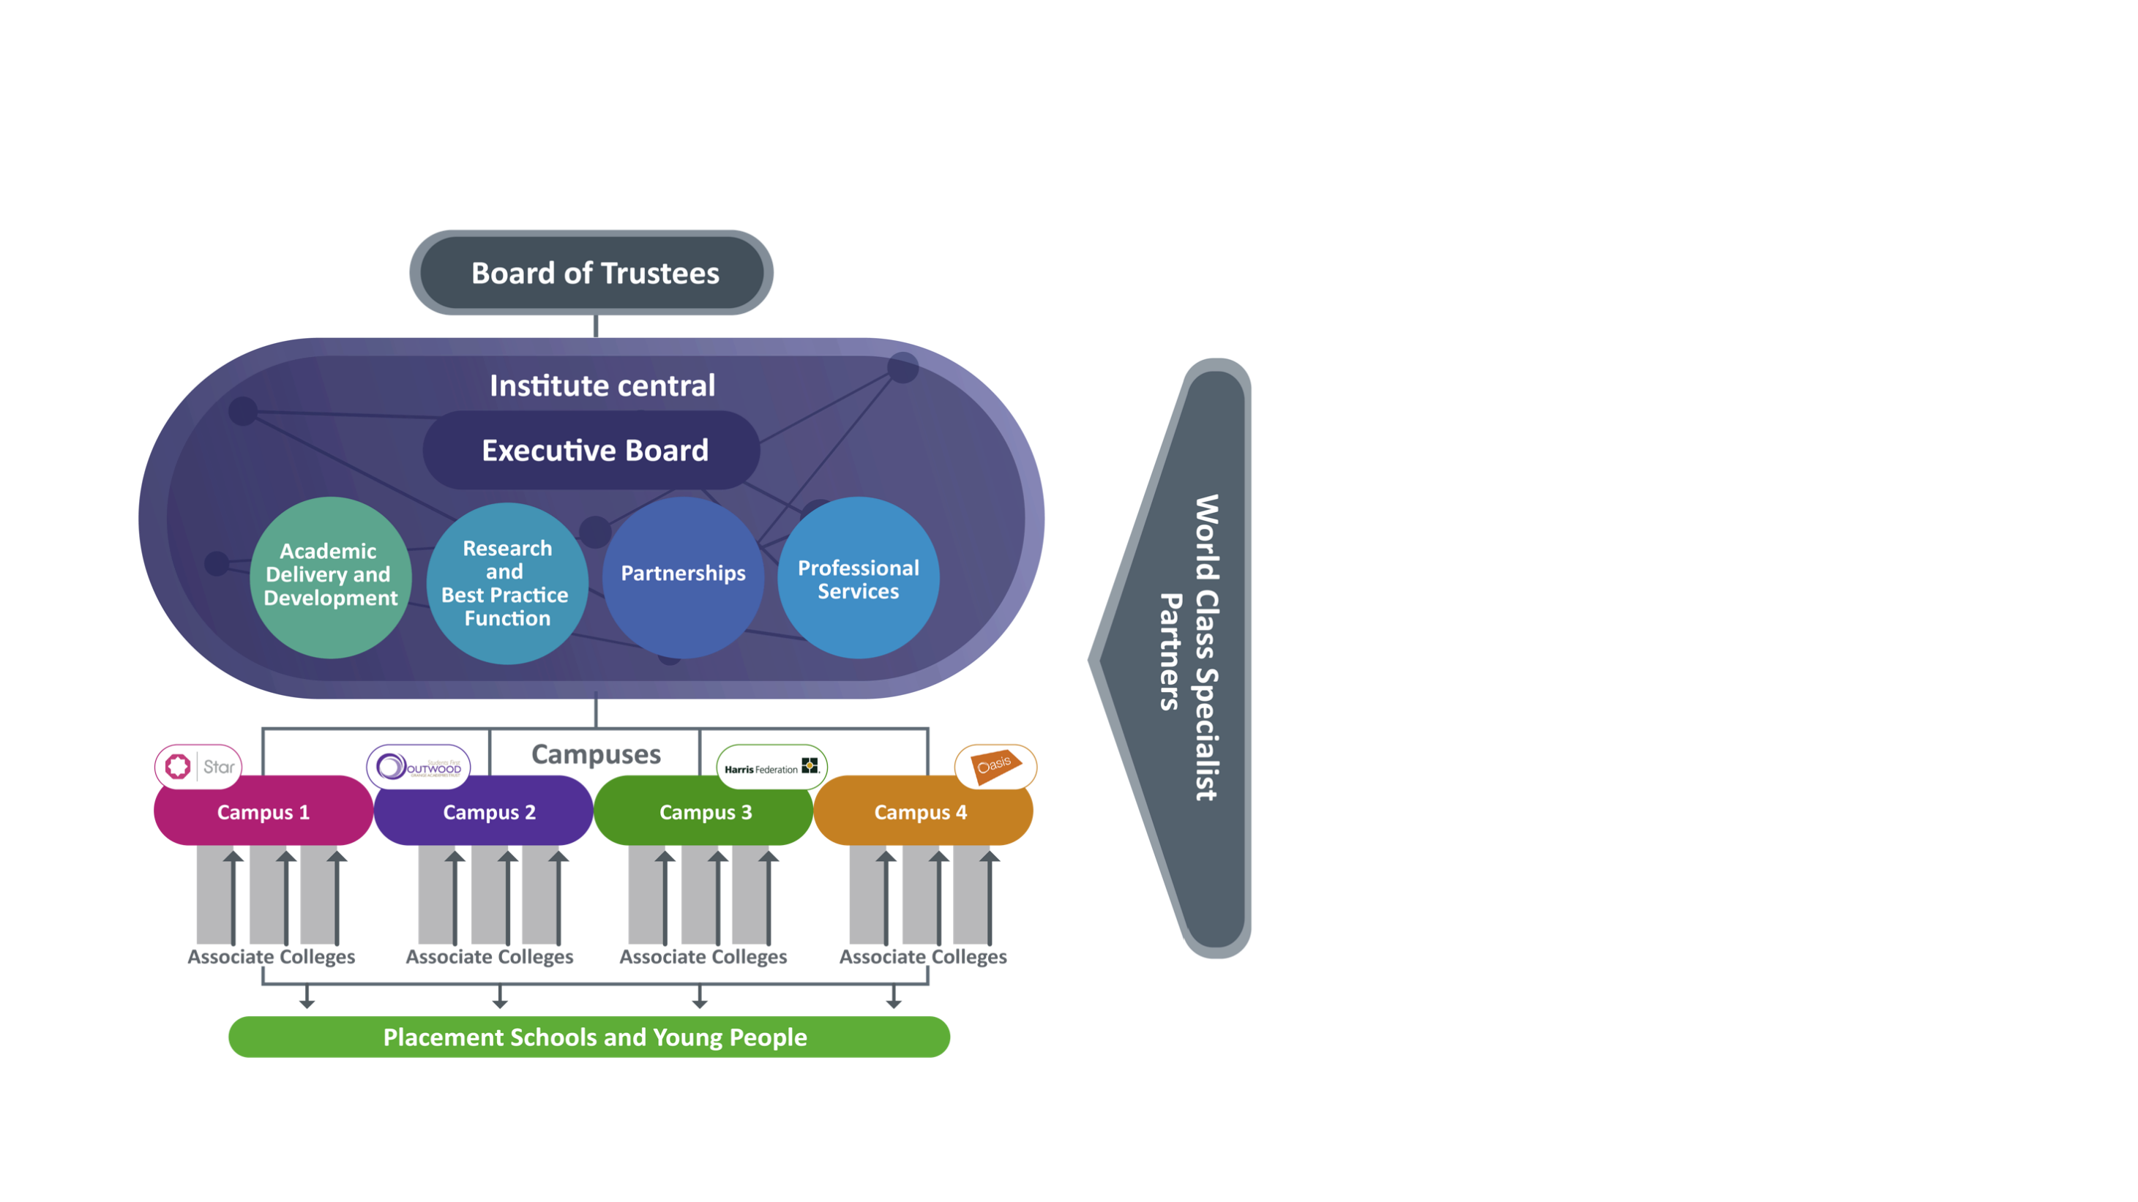
NIoT Organisational structure
Institute Central
Corporate Centre – Executive and Central Team
Centrally-defined curricula, quality assurance
Hosts Research & Best Practice Function, Partnerships, Professional Services
Institute Regional Campuses
Four Institute Campuses anchored by Foundation MATs
Part of the SLDT/IoT legal entity
Core staff are employed by SLDT
Contract additional flexible capacity from MATs.
Deliver SLDT-stipulated curriculum
Regional Campus Delivery Partners
Associate Colleges/Teaching Delivery Partners to ensure scale, reach cold spots and enhance capacity
Operate on a subcontractor basis
Deliver SLDT-stipulated curriculum

Slide 8
Employment Benefits
National Joint Council or School Teachers’ Pay & Conditions (depending on role)
Auto-enrolment to Local Government or Teachers’ Pension Scheme
25+ days holiday, plus bank holidays (for non-term time only employees) and flexible family-friendly policies
Significant investment in your continuing professional development (CPD)

Slide 9
Supporting staff health and wellbeing
Inclusive recruitment and retention practices
Mental Health at Work Commitment; DfE workload standards
Monthly wellbeing ‘pulse’ survey
Employee Assistance Programme
Discounted gym membership and sporting facilities

